Slide 1
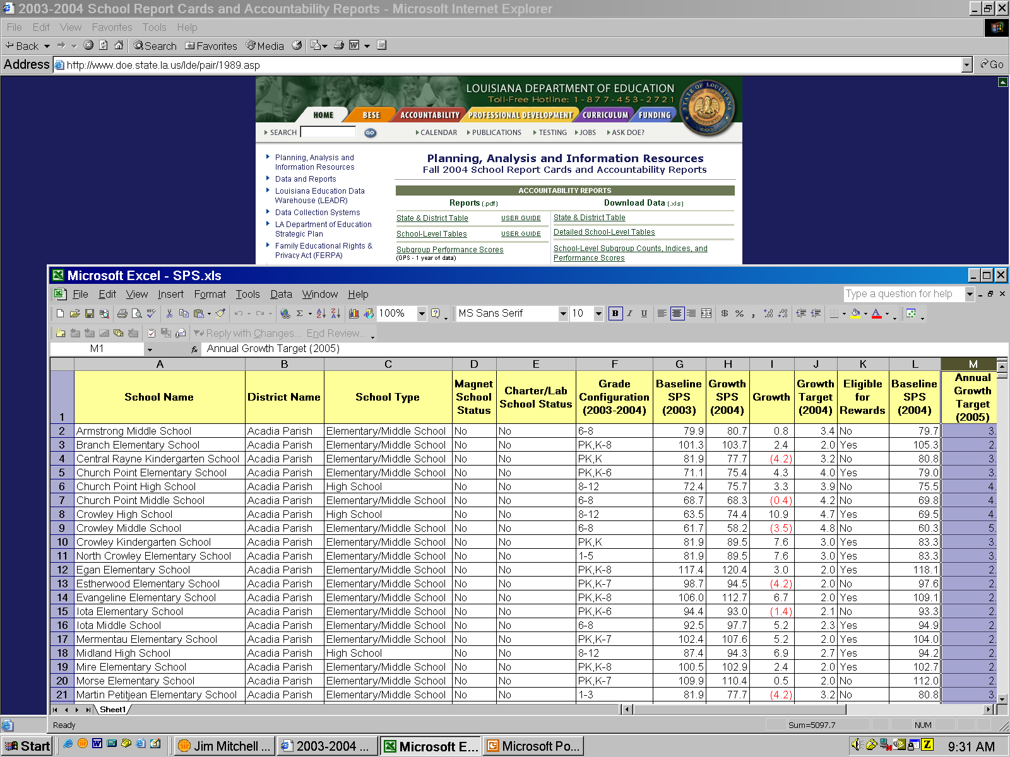
Louisiana has many sources of data available on the Internet.
For example, the Department of Education distributes School Accountability data.
Notes:
Data available on the web (background IE window) can be downloaded to the desktop and analyzed, there (Excel spreadsheet in foreground). But a map gives it a whole different perspective. It’s not just a table of numbers, anymore.

Slide 2
Notes:
From a statewide perspective, you can see where “hot spots” occur. Then you can look at potential causes and potential remedies. Is there a spatial pattern here?

Slide 3
Notes:
Zoom-in to Orleans Parish. Here, you can see the schools, highways, and Mass Transit rotes. But we need a closer look to find out what is happening to an individual school.

Slide 4
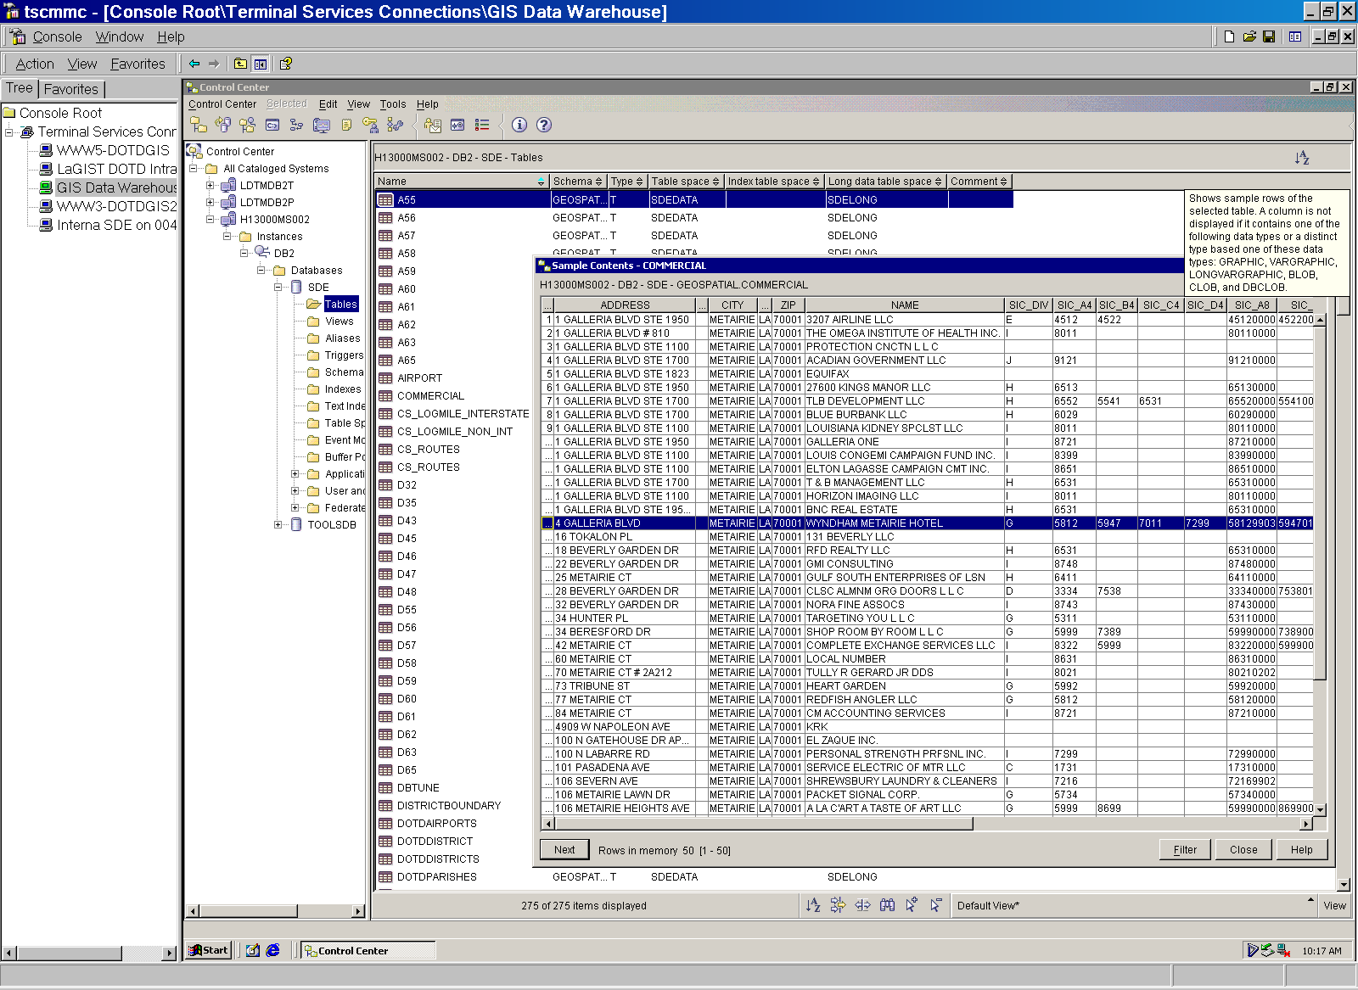
Agencies like DOTD already store data on businesses in the state.
Notes:
DOTD has databases of all commercial and residential locations in the state. For each, data are available on the type of business a company does. This is a view of that database table. This defines the “assets” that might be used to address the communities “needs.”

Slide 5
Notes:
A specific, underperforming school attendance zone can be identified and isolated on a map where assets can be identified. Here we can see churches, health and medical professionals, and child care facilities. All of these are assets that can be accessed in the local school’s neighborhood.

Slide 6
Where are the needs for Daycare?
Notes:
Finally, one of the needs can be seen, how many children live in the neighborhood, and where? Where are the assets and where are the transportation assets to serve this population? Now we have a grip in the problems and possible means for their solution.

